Slide 1
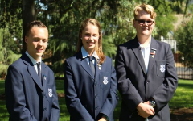

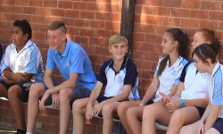

Stage 4
Parent Teacher Evening
WELLINGTON HIGH SCHOOL
20th March 2018

Slide 2
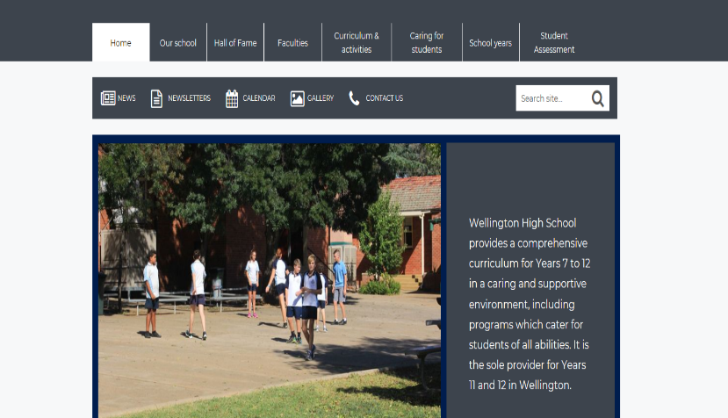
STUDENT ASSESSMENTS ON THE SCHOOL WEBSITE
Step 1: On the Wellington High website click Student Assessment

Slide 3
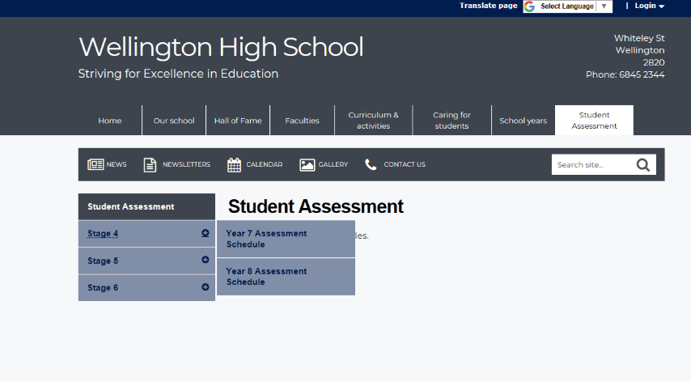
STUDENT ASSESSMENTS ON THE SCHOOL WEBSITE
Step 2: Hover over Stage 4 and then click on the student’s year

Slide 4
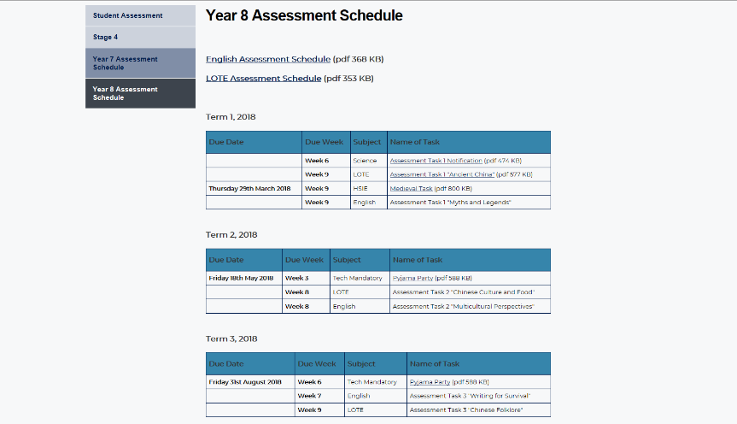
STUDENT ASSESSMENTS ON THE SCHOOL WEBSITE
Here you’ll find the Assessment Schedule for your child’s year group

Slide 5


EQUIPMENT
It is essential that students are coming prepared for their classes every day by bringing their correct equipment. Correct equipment includes:
  Books for every subject.
  Pencil cases with pens, pencils, glue, a ruler and calculator.
  Shoes for Tech Mandatory subjects
  Any work which has been assigned for homework or assessment sheets.

Slide 6

EQUIPMENT
It is important that students check their timetables every afternoon or night and pack their school bags for the following day.
Students are given their timetable at the start of every term, and they are encouraged to:
  Take a photo with their phones so they always have a copy.
  Send a copy to a friend and parents/ guardians so they are never without.
  Stick a copy somewhere in the house.
  New timetables can be acquired from the ladies in the front office.

Slide 7



FOOTWEAR GUIDELINES
Enclosed Leather footwear is required for the following
subjects:
Agriculture
Food Technology
Timber
Metal
Science

Slide 8
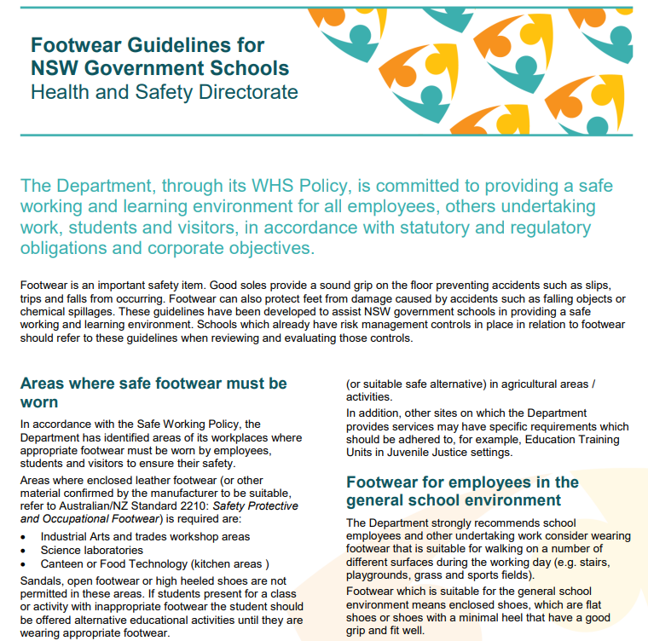

Slide 9
FOOTWEAR GUIDELINES
We do have some shoes on site to change into if required.
Most students bring shoes in and leave them in a labelled bag with the teacher.
Alternatively wear enclosed leather shoes on that day.
Correct footwear must be worn to participate in those lessons.
An alternative activity will be given to those not wearing appropriate footwear.

Slide 10

MOBILE PHONE POLICY
Students are not to be using mobile phones during class time - their phones and their headphones should be inside their bags (not their pockets) during class.
The consequence for using phones during class time is that it is to be taken to the office by the student and it can be picked up by their parents that afternoon.
Alternatively, some parents have negotiated for the phone to stay overnight at the school and the student can pick it up the following day after 3.08 pm.

Slide 11
MOBILE PHONE POLICY
Parents are also asked to help support the school with this policy by ensuring they are contacting the office to pass on messages or to speak to their child rather than texting or calling their child’s phone.
If you do wish to call them on their mobile phone during school hours ensure that it is either:
    Before school starts at 8.55 am
    Between the times of 11.02 am - 11.32 am or 1.36 pm - 2.06 pm during recess and lunch
    After school at 3.08 pm

Slide 12


CYBER BULLYING
STRATEGIES FOR STUDENTS
Collect evidence - screen captures
Block the person or group
Tell someone
Report to Social Media Service
Make a report to the eSafety Commissioner
If the issue comes into school,
report to:
  A Teacher
  Year Advisor
  Deputy
  Teachers Aid
  Anyone at School

Slide 13

CYBER BULLYING
STRATEGIES FOR PARENTS
Take a hands on approach:
Help with online tasks
Joint online activities
Listen to their online
problems
Helpful suggestions on how
to deal with problems
Monitor what they do:
Watch what they do online
Check browsing history
Check their social media profile
Check their
friends and
groups
Friend them

Slide 14
CYBER BULLYING
STRATEGIES FOR PARENTS
Speak to your child:
About online rules
What they can do online
Being responsible and
respectful
Ways to stay safe online
Have rules:
Limit length of time
Limit websites accessed
Times they can go online
Types of social media accounts
Suitability of apps
It is important for students to be getting enough sleep and to have some downtime from technology.

Slide 15
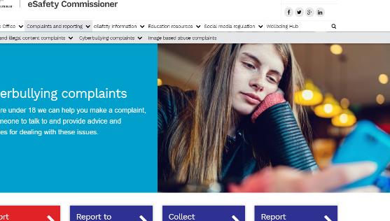
WHAT PARENTS SHOULD DO
IF YOUR CHILD IS BEING CYBER BULLIED
Report to social media service
Collect screen captures
Make a report to the eSafety commissioner
Block those who are texting your child
Contact those if they are sending Image Based Abuse to remove it or delete it
If it is Image Based Abuse (IBA) contact police after completing the other steps.

Slide 16
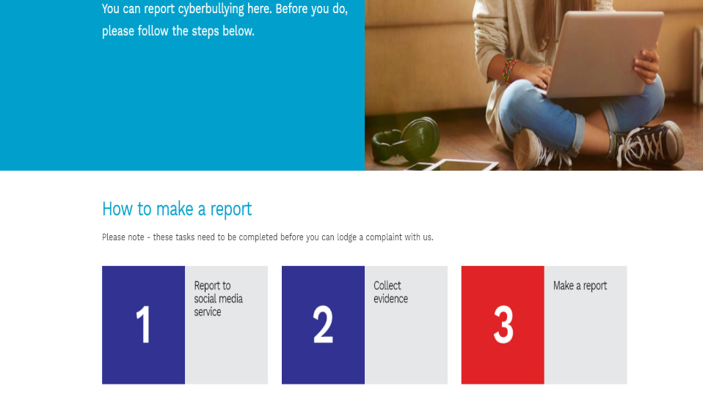
THE ESAFETY COMMISSIONER WEBSITE – HOW TO MAKE A REPORT

Slide 17
WELLINGTON HIGH SCHOOL
RESPONSE TO CYBER BULLYING INCIDENTS
Screen captures and reports will be taken.
Any phones with material will have the material deleted.
Parents will be contacted.
Suspensions under the Department of Education policy “Aggressive Behaviour” may result.
Victims and perpetrators will be supported through Informal and Formal Circles involving parents, students, community members, police liaison office and everyday students with plans made on how to move forward from the issue with clear acknowledgement of harm caused by the issue.
Support people will be identified for both the victim and perpetrator to help in the process of moving forward.

Slide 18
DEFINITION OF BULLYING
Bullying is an ongoing misuse of power in relationships through repeated verbal, physical and/or social behaviour that causes physical and/or psychological harm.
It can involve an individual or a group misusing their power over one or more persons. Bullying can happen in person or online, and it can be obvious (overt) or hidden (covert).

Slide 19

We believe empathy is the antidote to bullying
“I know exactly how you feel”

Slide 20
WELLINGTON HIGH SCHOOL IS A RESTORATIVE PRACTICES HIGH SCHOOL
At Wellington High School we believe in working with students, parents and community members in acknowledging the harm caused to a student or group and focusing on repairing the harm done and restoring relationships. The emphasis is on planning a way to move forward.
How do we do this:
Through circles

Slide 21
FORMAL CIRCLES
When things go wrong for our young people, a formal circle may occur.
These circles can involve students concerned, parents/Carers, AEOs, PCYC police, facilitators and 3 to 5 everyday students. It has a set format based on real accountability with students making plans with support to put right the harm caused.

Slide 22

FORMAL CIRCLES
Restorative circles are about moving forward from what has happened - not staying in the anger.
They’re about supporting students to problem solve and make plans for the future with an emphasis on support and repairing harm.

Slide 23

FORMAL CIRCLES
Here are some examples of questions asked.
What happened?
What were you thinking at the time?
What have you thought about since?
Who has been affected by what you did? And in what way?
What do you think you need to do to make things right?

Slide 24
INFORMAL CIRCLES
Informal Circles are smaller and usually consist of students and/or parents with facilitators and AEOS. They are based on the questions covered in the previous slide.
Students formulate plans and agree to move forward with written plans put into place and signed. All students identify support people to check in with them.

Slide 25
SUPPORT CIRCLES
Support Circles occur if there is a raised concern with a student. Teachers, parents and support such as AEO’s Learning Centre staff come together with a circle convenor to:
Explore the issues.
Formulate agreed upon plans or referrals.
Place timeframes and review dates in place (usually 5 weeks).

